Slide 1

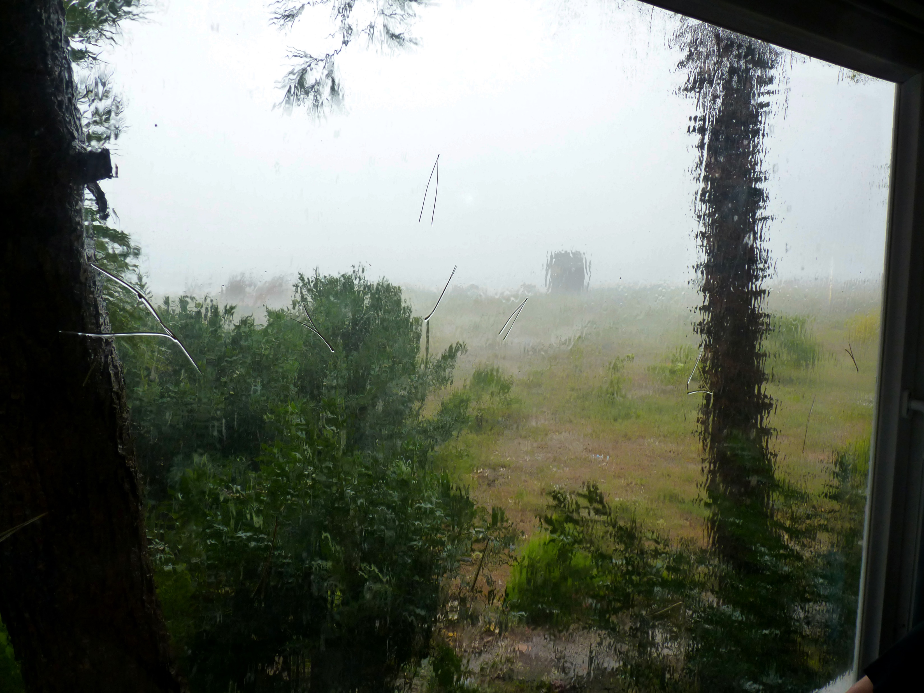

The approaching menace Ezekiel 3:16-5:17

Slide 2
The approaching menace Ezekiel 3:16-5:17
Drama

Slide 3
The approaching menace Ezekiel 3:16-5:17
Drama
Painful symbols

Slide 4
The approaching menace Ezekiel 3:16-5:17
A daunting challenge 3:16-27

Slide 5
The approaching menace Ezekiel 3:16-5:17
A daunting challenge 3:16-27
Accountability

Slide 6
The approaching menace Ezekiel 3:16-5:17
A daunting challenge 3:16-27
Accountability
“Watchmen must keep awake, be they ever so sleepy, and keep abroad, be it ever so cold; they must stand all weathers upon the watch-tower …” Matthew Henry:

Slide 7
The approaching menace Ezekiel 3:16-5:17
A daunting challenge 3:16-27
Accountability
Friend or foe?

Slide 8
The approaching menace Ezekiel 3:16-5:17
A daunting challenge 3:16-27
Accountability
Friend or foe?
The ‘foe’ = the Lord (v.17)

Slide 9
The approaching menace Ezekiel 3:16-5:17
A daunting challenge 3:16-27
Accountability
Friend or foe?
The ‘foe’ = the Lord (v.17)
Who placed the watchman?

Slide 10
The approaching menace Ezekiel 3:16-5:17
A daunting challenge 3:16-27
Accountability
Friend or foe?
The ‘foe’ = the Lord (v.17)
Who placed the watchman?
Tension between judgment v. grace (18:31)

Slide 11
The approaching menace Ezekiel 3:16-5:17
A daunting challenge 3:16-27
Accountability
Friend or foe?
The ‘foe’ = the Lord (v.17)
Who placed the watchman?
Tension between judgment v. grace (18:31)
Fresh marching orders

Slide 12
The approaching menace Ezekiel 3:16-5:17
A daunting challenge 3:16-27
Accountability
Friend or foe?
The ‘foe’ = the Lord (v.17)
Who placed the watchman?
Tension between judgment v. grace (18:31)
Fresh marching orders
God won’t take ‘no’ for an answer

Slide 13
The approaching menace Ezekiel 3:16-5:17
A daunting challenge 3:16-27
Accountability
Friend or foe?
The ‘foe’ = the Lord (v.17)
Who placed the watchman?
Tension between judgment v. grace (18:31)
Fresh marching orders
God won’t take ‘no’ for an answer
Strange behaviour

Slide 14
The approaching menace Ezekiel 3:16-5:17
A daunting challenge 3:16-27
Accountability
Friend or foe?
The ‘foe’ = the Lord (v.17)
Who placed the watchman?
Tension between judgment v. grace (18:31)
Fresh marching orders
God won’t take ‘no’ for an answer
Strange behaviour
Mental health issues?

Slide 15
The approaching menace Ezekiel 3:16-5:17
A daunting challenge 3:16-27
Accountability
Friend or foe?
The ‘foe’ = the Lord (v.17)
Who placed the watchman?
Tension between judgment v. grace (18:31)
Fresh marching orders
God won’t take ‘no’ for an answer
Strange behaviour
Mental health issues?
No mediation

Slide 16
The approaching menace Ezekiel 3:16-5:17
A daunting challenge 3:16-27
Accountability
Friend or foe?
The ‘foe’ = the Lord (v.17)
Who placed the watchman?
Tension between judgment v. grace (18:31)
Fresh marching orders
God won’t take ‘no’ for an answer
Strange behaviour
Mental health issues?
No mediation
House arrest

Slide 17
The approaching menace Ezekiel 3:16-5:17
A daunting challenge 3:16-27
The drama 4:1-5:4

Slide 18
The approaching menace Ezekiel 3:16-5:17
A daunting challenge 3:16-27
The drama 4:1-5:4
Act 1: A city under siege (4:1-8)

Slide 19
The approaching menace Ezekiel 3:16-5:17
A daunting challenge 3:16-27
The drama 4:1-5:4
Act 1: A city under siege (4:1-8)
Scene 1 Clay model of Jerusalem

Slide 20
The approaching menace Ezekiel 3:16-5:17
A daunting challenge 3:16-27
The drama 4:1-5:4
Act 1: A city under siege (4:1-8)
Scene 1 Clay model of Jerusalem
An iron barrier

Slide 21
The approaching menace Ezekiel 3:16-5:17
A daunting challenge 3:16-27
The drama 4:1-5:4
Act 1: A city under siege (4:1-8)
Scene 1 Clay model
Iron barrier
Scene 2 Sin bearer

Slide 22
The approaching menace Ezekiel 3:16-5:17
A daunting challenge 3:16-27
The drama 4:1-5:4
Act 1: A city under siege (4:1-8)
Scene 1 Clay model
Iron barrier
Scene 2 Sin bearer
Message to fellow-exiles

Slide 23
The approaching menace Ezekiel 3:16-5:17
A daunting challenge 3:16-27
The drama 4:1-5:4
Act 1: A city under siege (4:1-8)
Scene 1 Clay model
Iron barrier
Scene 2 Sin bearer
Message to fellow-exiles
Bearing sin of the nation

Slide 24
The approaching menace Ezekiel 3:16-5:17
A daunting challenge 3:16-27
The drama 4:1-5:4
Act 1: A city under siege (4:1-8)
Act 2: Bread of affliction (4:9-17)

Slide 25
The approaching menace Ezekiel 3:16-5:17
A daunting challenge 3:16-27
The drama 4:1-5:4
Act 1: A city under siege (4:1-8)
Act 2: Bread of affliction (4:9-17)
Scene 1: Siege rations (vv.9-11)

Slide 26
The approaching menace Ezekiel 3:16-5:17
A daunting challenge 3:16-27
The drama 4:1-5:4
Act 1: A city under siege (4:1-8)
Act 2: Bread of affliction (4:9-17)
Scene 1: Siege rations (vv.9-11)
Scene 2: Defiled food (vv.12-17)

Slide 27
The approaching menace Ezekiel 3:16-5:17
A daunting challenge 3:16-27
The drama 4:1-5:4
Act 1: A city under siege (4:1-8)
Act 2: Bread of affliction (4:9-17)
Scene 1: Siege rations (vv.9-11)
Scene 2: Defiled food (vv.12-17)
No more bread sticks

Slide 28
The approaching menace Ezekiel 3:16-5:17
A daunting challenge 3:16-27
The drama 4:1-5:4
Act 1: A city under siege (4:1-8)
Act 2: Bread of affliction (4:9-17)
Act 3: The Great Fire (5:1-4)

Slide 29
The approaching menace Ezekiel 3:16-5:17
A daunting challenge 3:16-27
The drama 4:1-5:4
Act 1: A city under siege (4:1-8)
Act 2: Bread of affliction (4:9-17)
Act 3: The Great Fire (5:1-4)
Scene 1: Shaved! (v:1)

Slide 30
The approaching menace Ezekiel 3:16-5:17
A daunting challenge 3:16-27
The drama 4:1-5:4
Act 1: A city under siege (4:1-8)
Act 2: Bread of affliction (4:9-17)
Act 3: The Great Fire (5:1-4)
Scene 1: Shaved! (v:1)
Scene 2: Fire, sword and wind (v.2-3)

Slide 31
The approaching menace Ezekiel 3:16-5:17
A daunting challenge 3:16-27
The drama 4:1-5:4
Act 1: A city under siege (4:1-8)
Act 2: Bread of affliction (4:9-17)
Act 3: The Great Fire (5:1-4)
Scene 1: Shaved! (v:1)
Scene 2: Fire, sword and wind (v.2-3)
Scene 3: Loose hairs (v.4)

Slide 32
The approaching menace Ezekiel 3:16-5:17
A daunting challenge 3:16-27
The drama 4:1-5:4
The Interpretation 5:5-17

Slide 33
The approaching menace Ezekiel 3:16-5:17
A daunting challenge 3:16-27
The drama 4:1-5:4
The Interpretation 5:5-17
Jerusalem – centre of the nations (v.5)

Slide 34
The approaching menace Ezekiel 3:16-5:17
A daunting challenge 3:16-27
The drama 4:1-5:4
The Interpretation 5:5-17
Jerusalem – centre of the nations (v.5)
Jerusalem – worse than others (v.6-7)

Slide 35
The approaching menace Ezekiel 3:16-5:17
A daunting challenge 3:16-27
The drama 4:1-5:4
The Interpretation 5:5-17
Jerusalem – centre of the nations (v.5)
Jerusalem – worse than others (v.6-7)
“Instead of being a light to the world, by failing to live in the light of God’s revelation, this chosen city had become the world’s darkest blot”

Slide 36
The approaching menace Ezekiel 3:16-5:17
A daunting challenge 3:16-27
The drama 4:1-5:4
The Interpretation 5:5-17
Jerusalem – centre of the nations (v.5)
Jerusalem – worse than others (v.6-7)
Jerusalem – a warning (v.8-17)

Slide 37
The approaching menace Ezekiel 3:16-5:17
A daunting challenge 3:16-27
The drama 4:1-5:4
The Interpretation 5:5-17
Jerusalem – centre of the nations (v.5)
Jerusalem – worse than others (v.6-7)
Jerusalem – a warning (v.8-17)
Reason for judgment = “abominations”

Slide 38
The approaching menace Ezekiel 3:16-5:17
A daunting challenge 3:16-27
The drama 4:1-5:4
The Interpretation 5:5-17
Jerusalem – centre of the nations (v.5)
Jerusalem – worse than others (v.6-7)
Jerusalem – a warning (v.8-17)
Reason for judgment = “abominations”
Object lesson for other nations

Slide 39
The approaching menace Ezekiel 3:16-5:17
A daunting challenge 3:16-27
The drama 4:1-5:4
The Interpretation 5:5-17
Jerusalem – centre of the nations (v.5)
Jerusalem – worse than others (v.6-7)
Jerusalem – a warning (v.8-17)
Lessons

Slide 40
The approaching menace Ezekiel 3:16-5:17
A daunting challenge 3:16-27
The drama 4:1-5:4
The Interpretation 5:5-17
Jerusalem – centre of the nations (v.5)
Jerusalem – worse than others (v.6-7)
Jerusalem – a warning (v.8-17)
Lessons
God hates sin

Slide 41
The approaching menace Ezekiel 3:16-5:17
A daunting challenge 3:16-27
The drama 4:1-5:4
The Interpretation 5:5-17
Jerusalem – centre of the nations (v.5)
Jerusalem – worse than others (v.6-7)
Jerusalem – a warning (v.8-17)
Lessons
God hates sin
God is patient - but there are limits!

Slide 42
The approaching menace Ezekiel 3:16-5:17
A daunting challenge 3:16-27
The drama 4:1-5:4
The Interpretation 5:5-17
Jerusalem – centre of the nations (v.5)
Jerusalem – worse than others (v.6-7)
Jerusalem – a warning (v.8-17)
Lessons
God hates sin
God is patient - but there are limits!
Cloud’s have silver linings

Slide 43
The approaching menace Ezekiel 3:16-5:17
A daunting challenge 3:16-27
The drama 4:1-5:4
The Interpretation 5:5-17
Jerusalem – centre of the nations (v.5)
Jerusalem – worse than others (v.6-7)
Jerusalem – a warning (v.8-17)
Lessons
God hates sin
God is patient - but there are limits!
Cloud’s have silver linings
We have a wonderful Saviour!

